Slide 1

Capture the flag – computer security games
Kathryn Lybarger @ZEMKAT Online Unconference of Niche Interests 2020-08-09

Slide 2
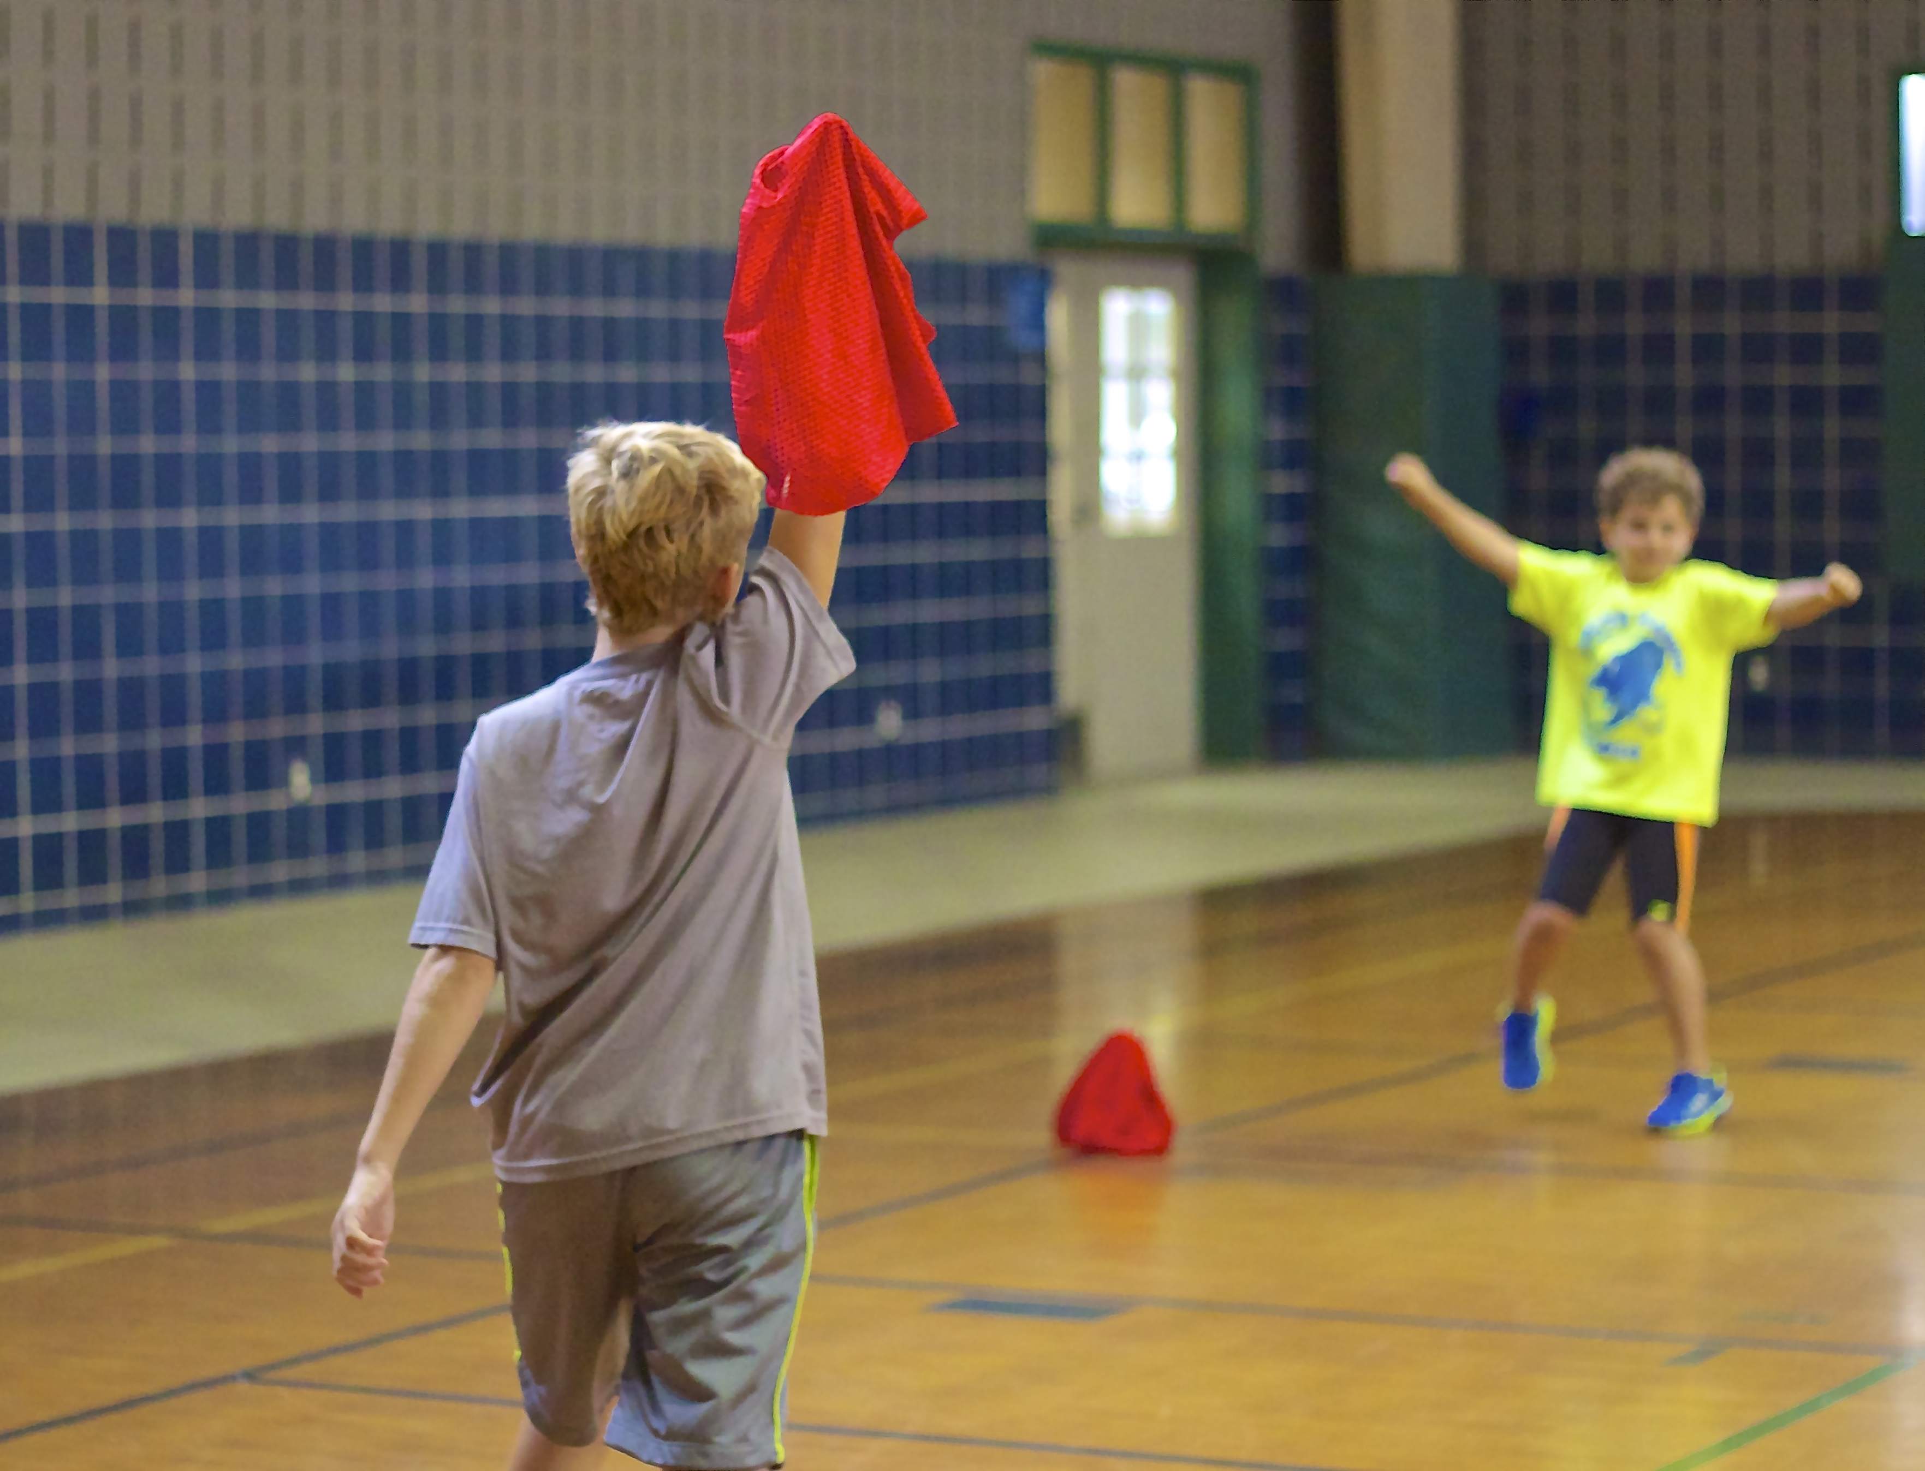
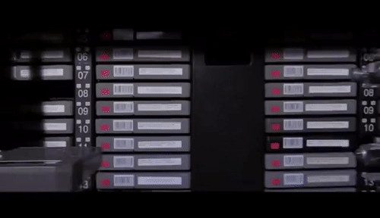
Capture the flag?

Slide 3
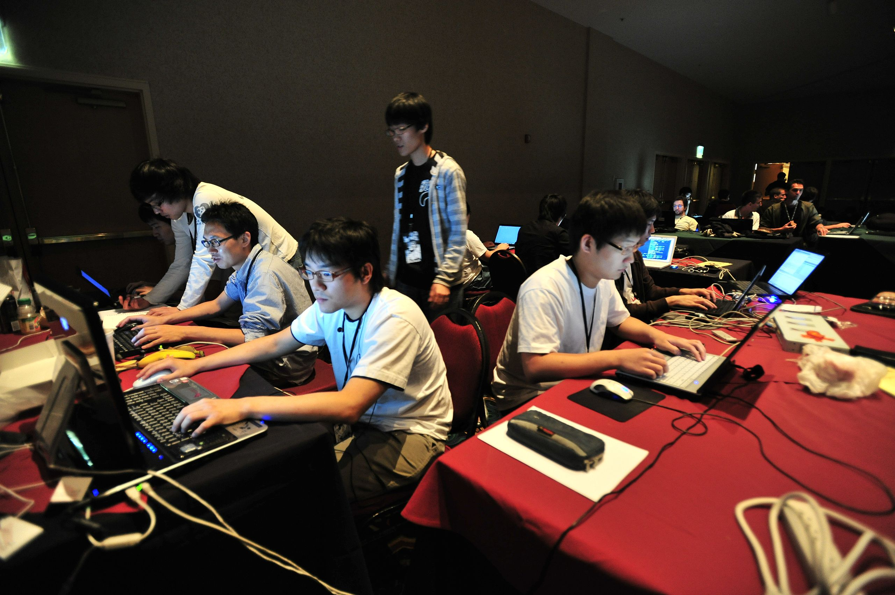
Capture the flag (CTF) – jeopardy style
Individual or team competition
“Flags” are hidden in a set of challenges
NicheCTF{y0u_f0und_1t}
Earn points by submitting flags
In-person or remote
Time-limited or open

Slide 4
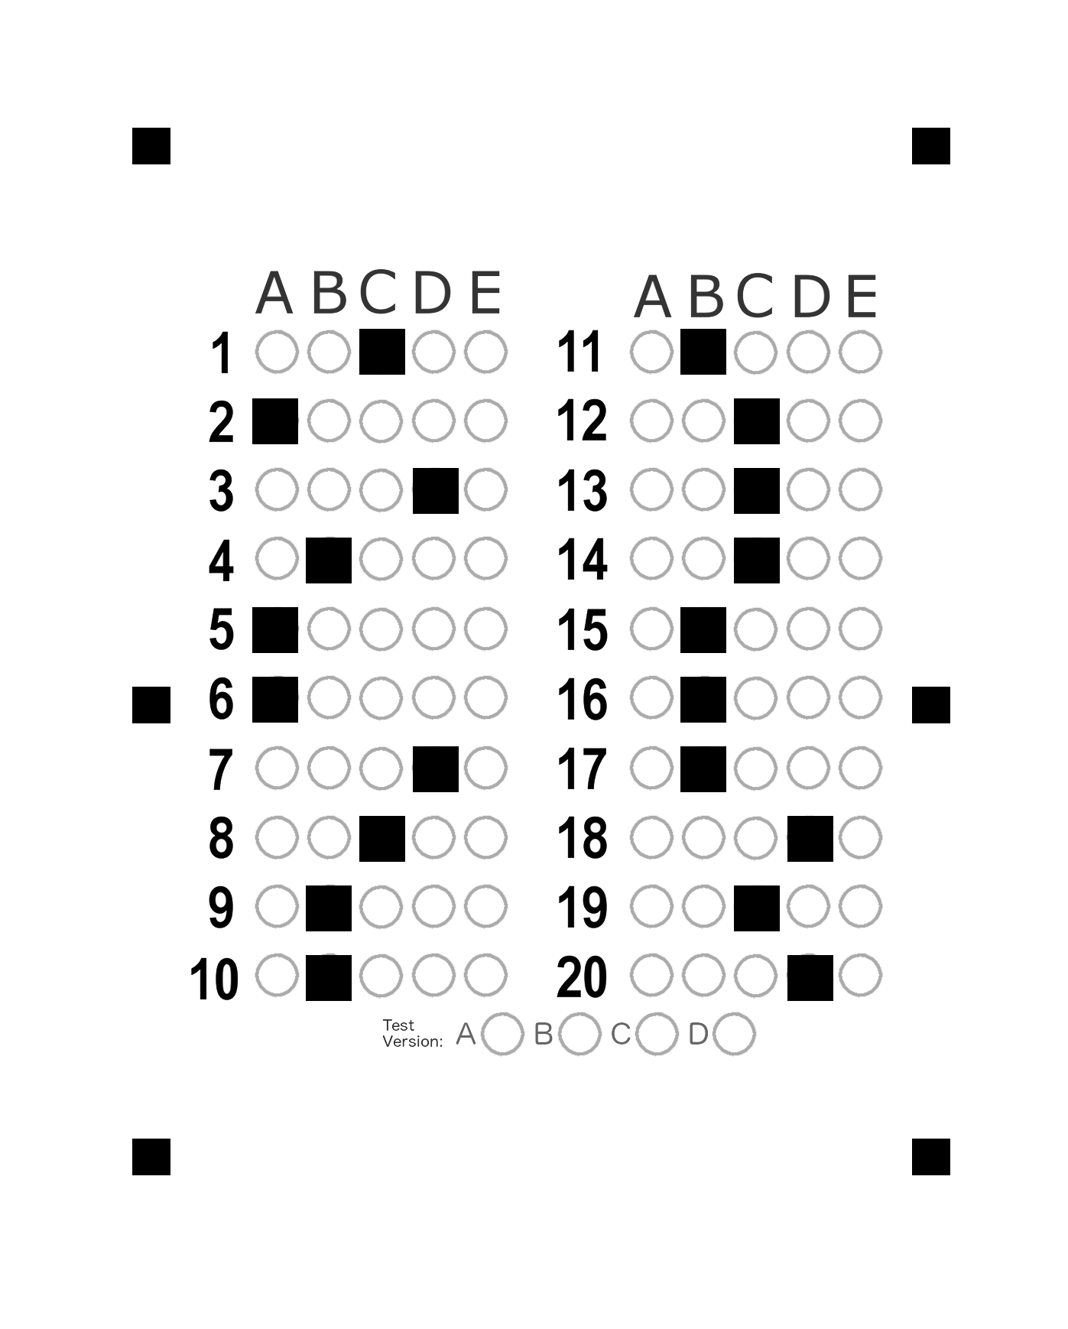
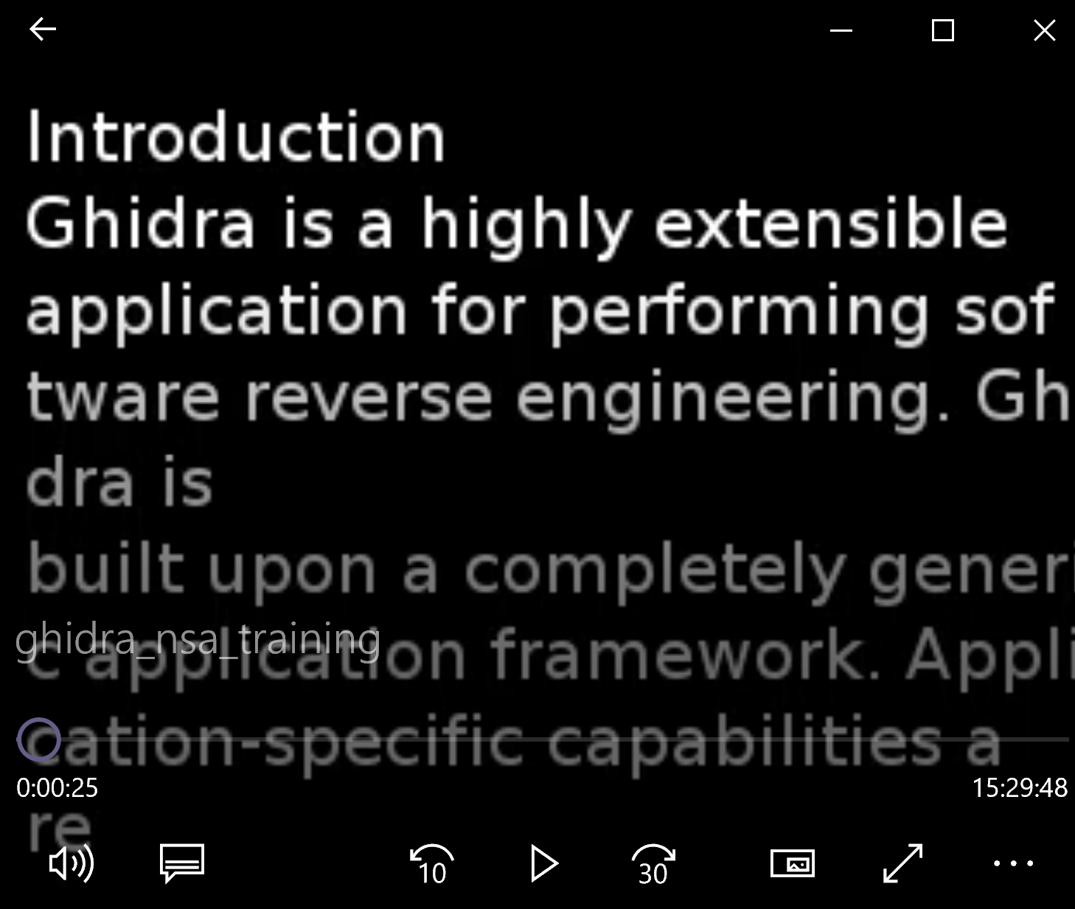
Ctf challenge examples
Swamp CTF (UF), 2019
Sunshine CTF (UCF), 2019

Slide 5
CTF challenges
Divided into categories
Increasing in difficulty within a category
Worth different numbers of points
Intentionally “vulnerable”
Programming may be required
Crack Me 1
(100)
Crack Me 2
(250)
Crack Me 3
(500)
Reversing
Easy Rev
(50)
Hard Rev
(200)

Slide 6
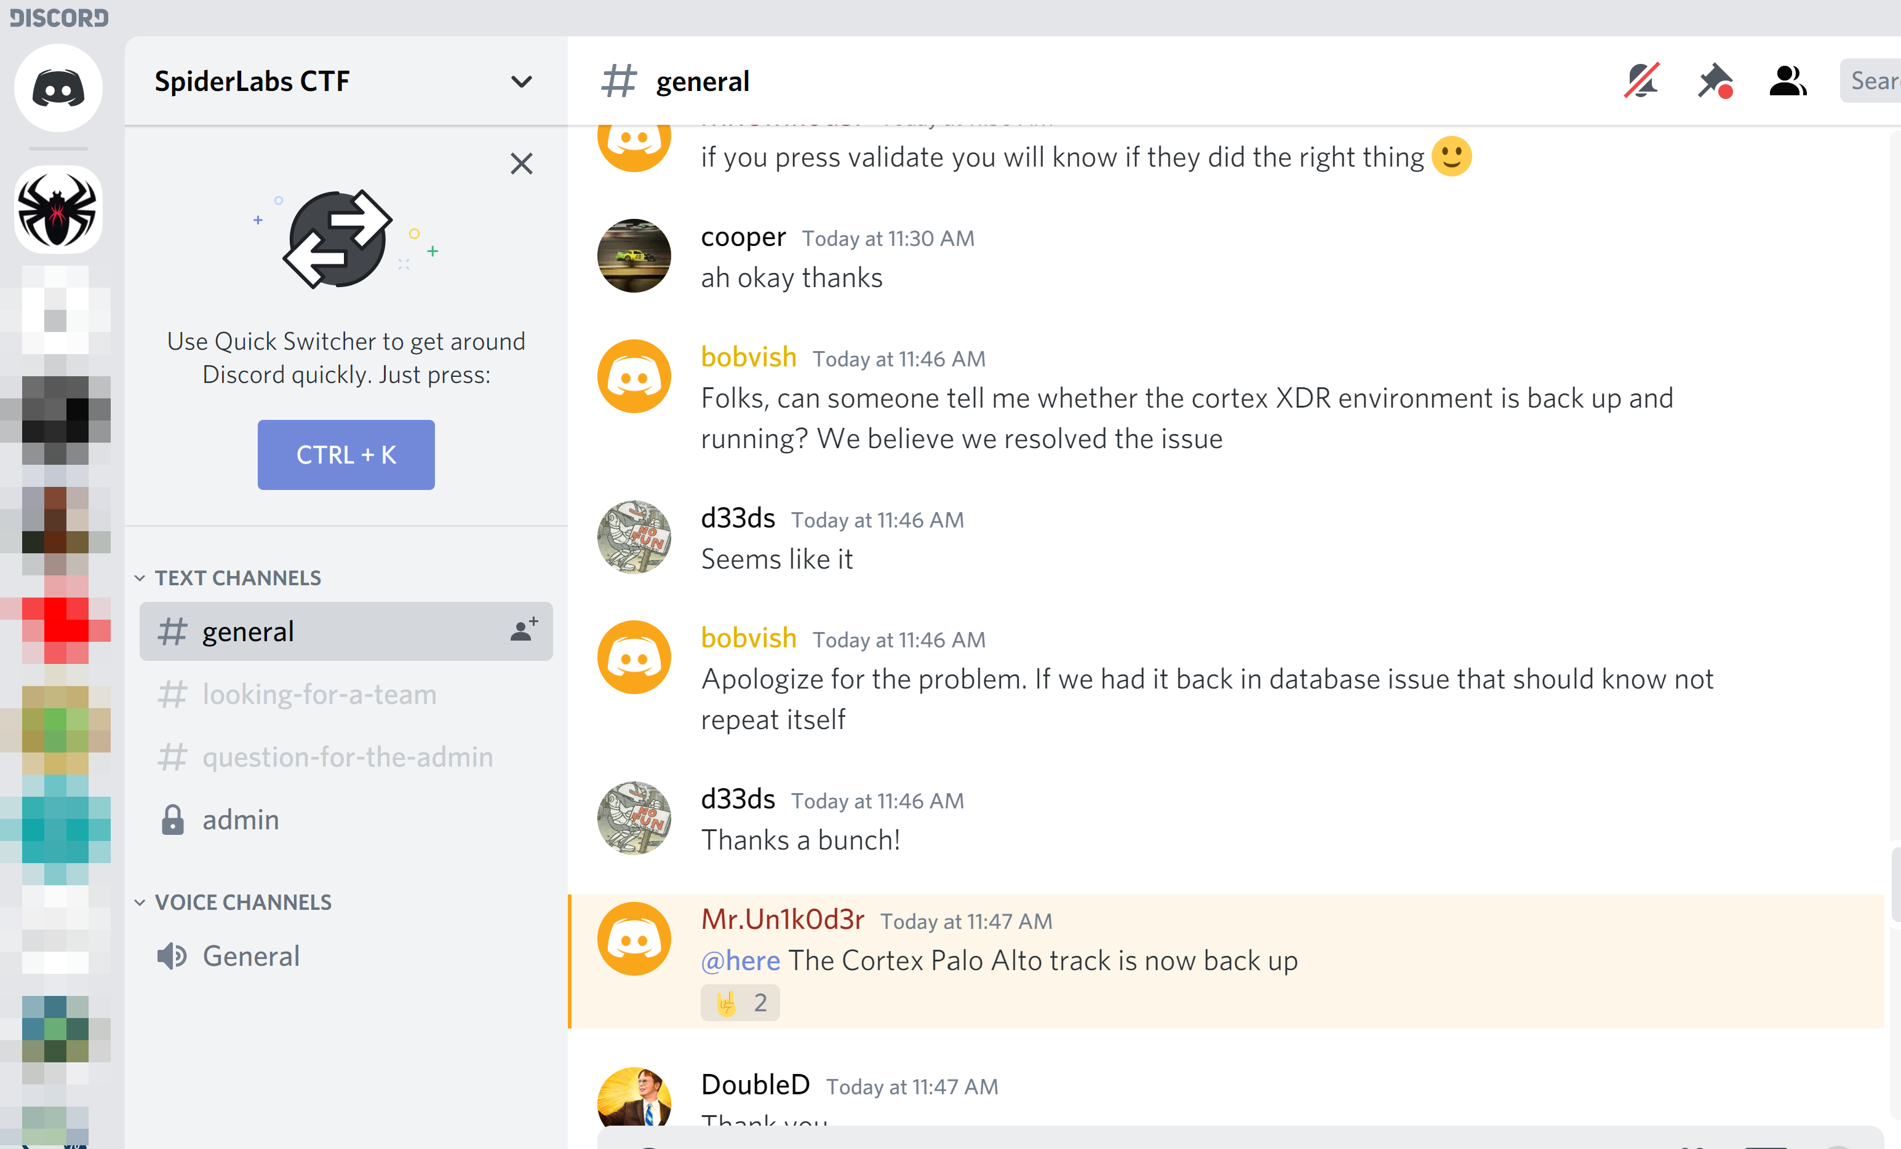
Category: warmup
Easier challenges
Helps you to:
Recognize flags
Understand how to submit them
Connect with admins, and others competing in the CTF

Slide 7
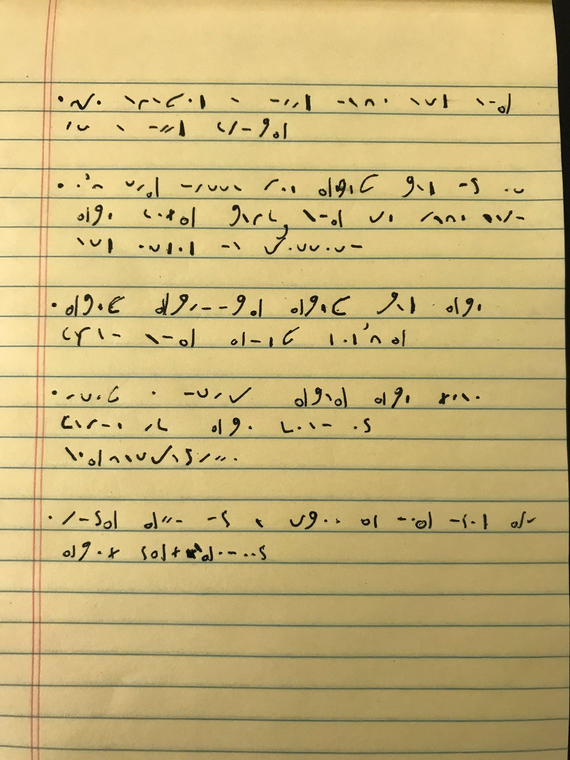
Category: cryptography
Classical ciphers
Caesar Cipher (such as ROT13)
Vigenère Cipher
Modern cryptography
RSA
AES
Other codes and ciphers

Slide 8
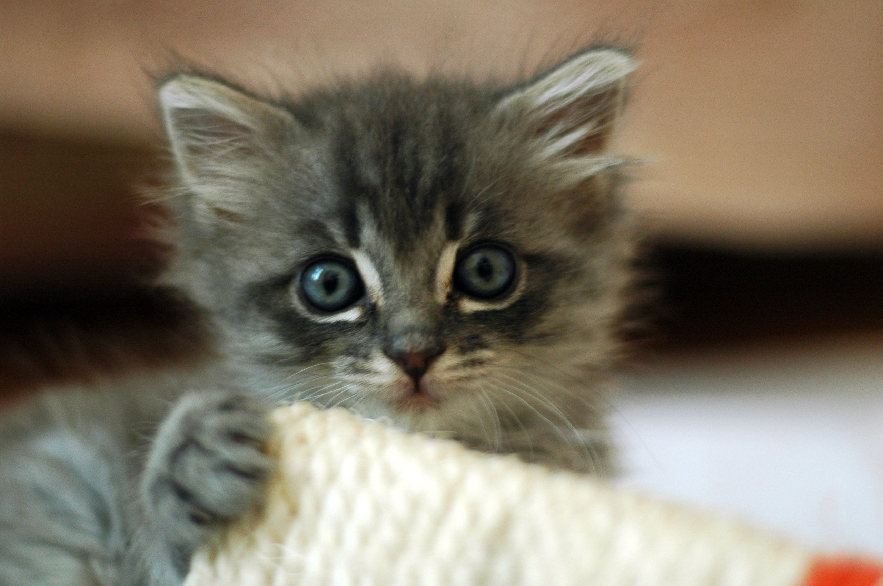
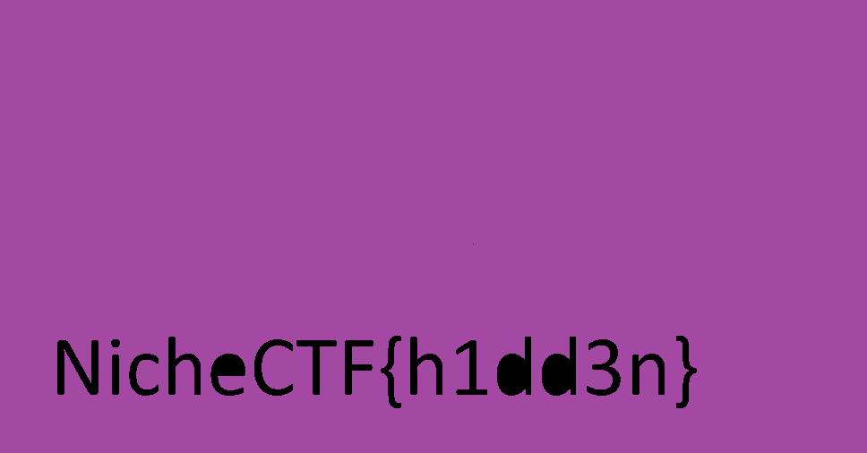
Category: Steganography
Concealing a message secretly within other content
Could be hidden text within:
Other text files
Image files
Sound files
Video files

Slide 9
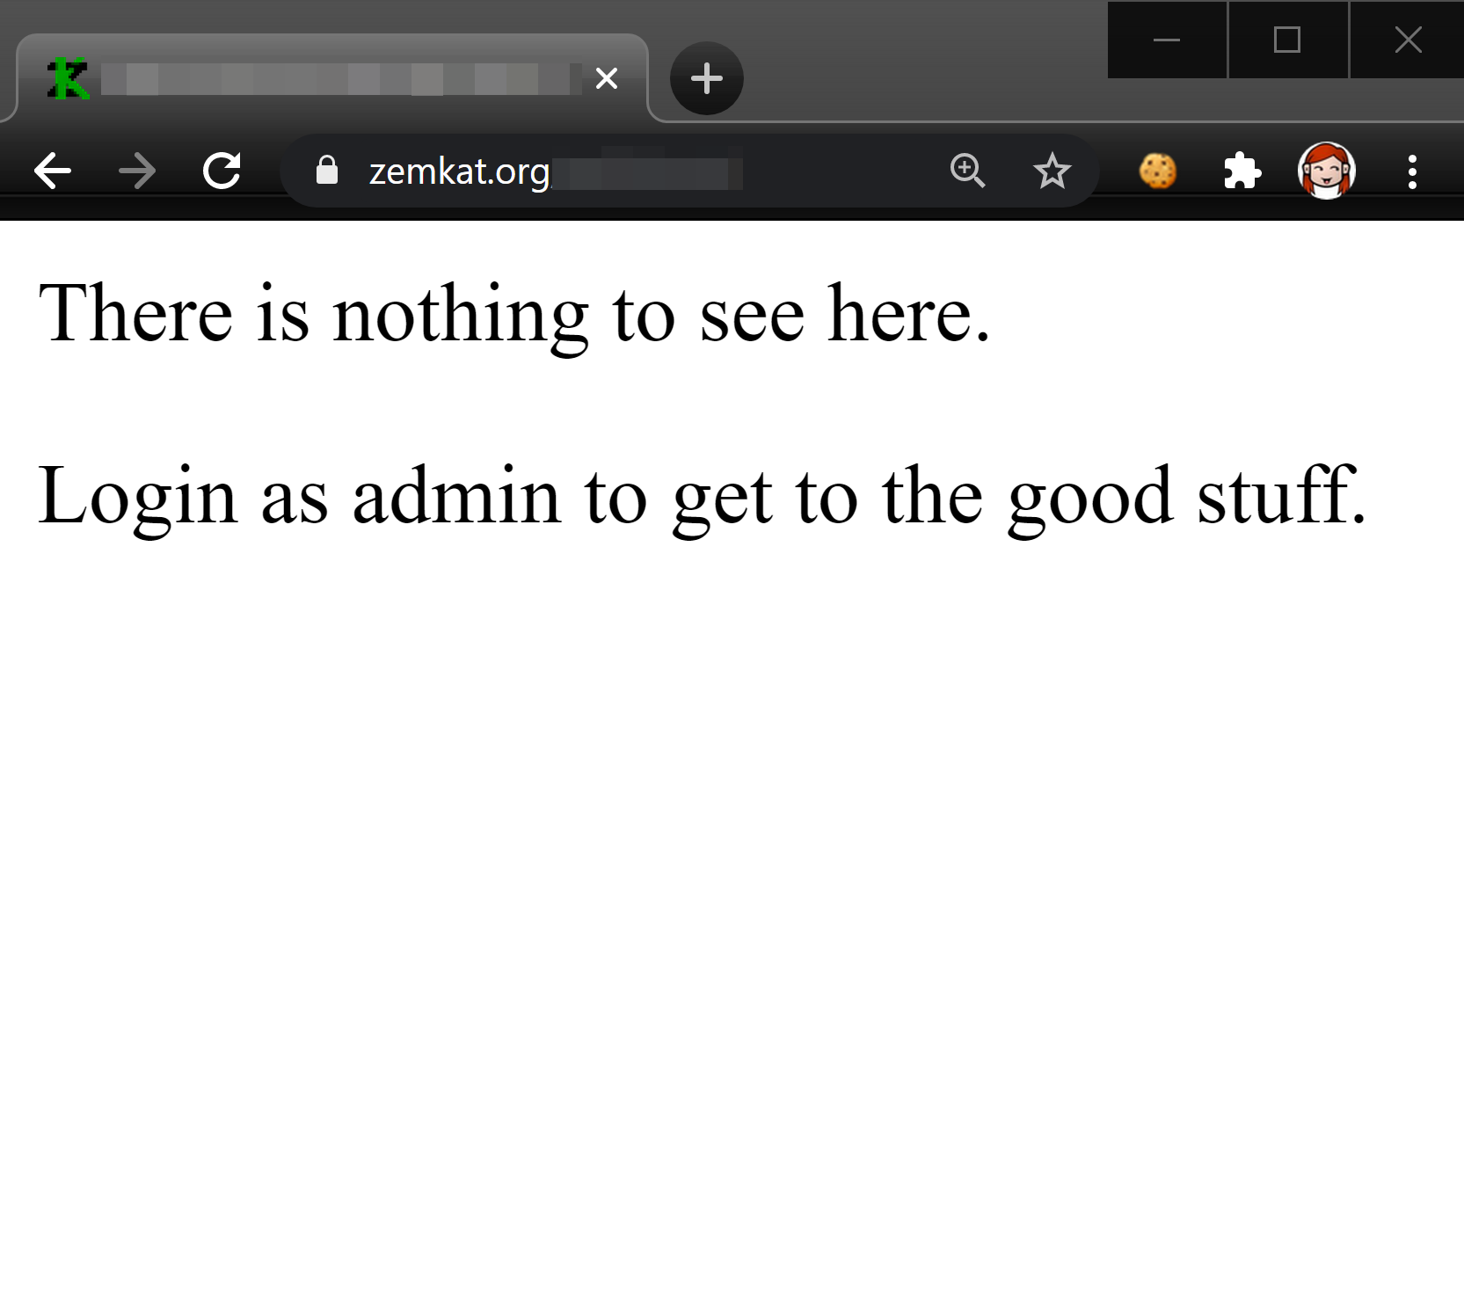
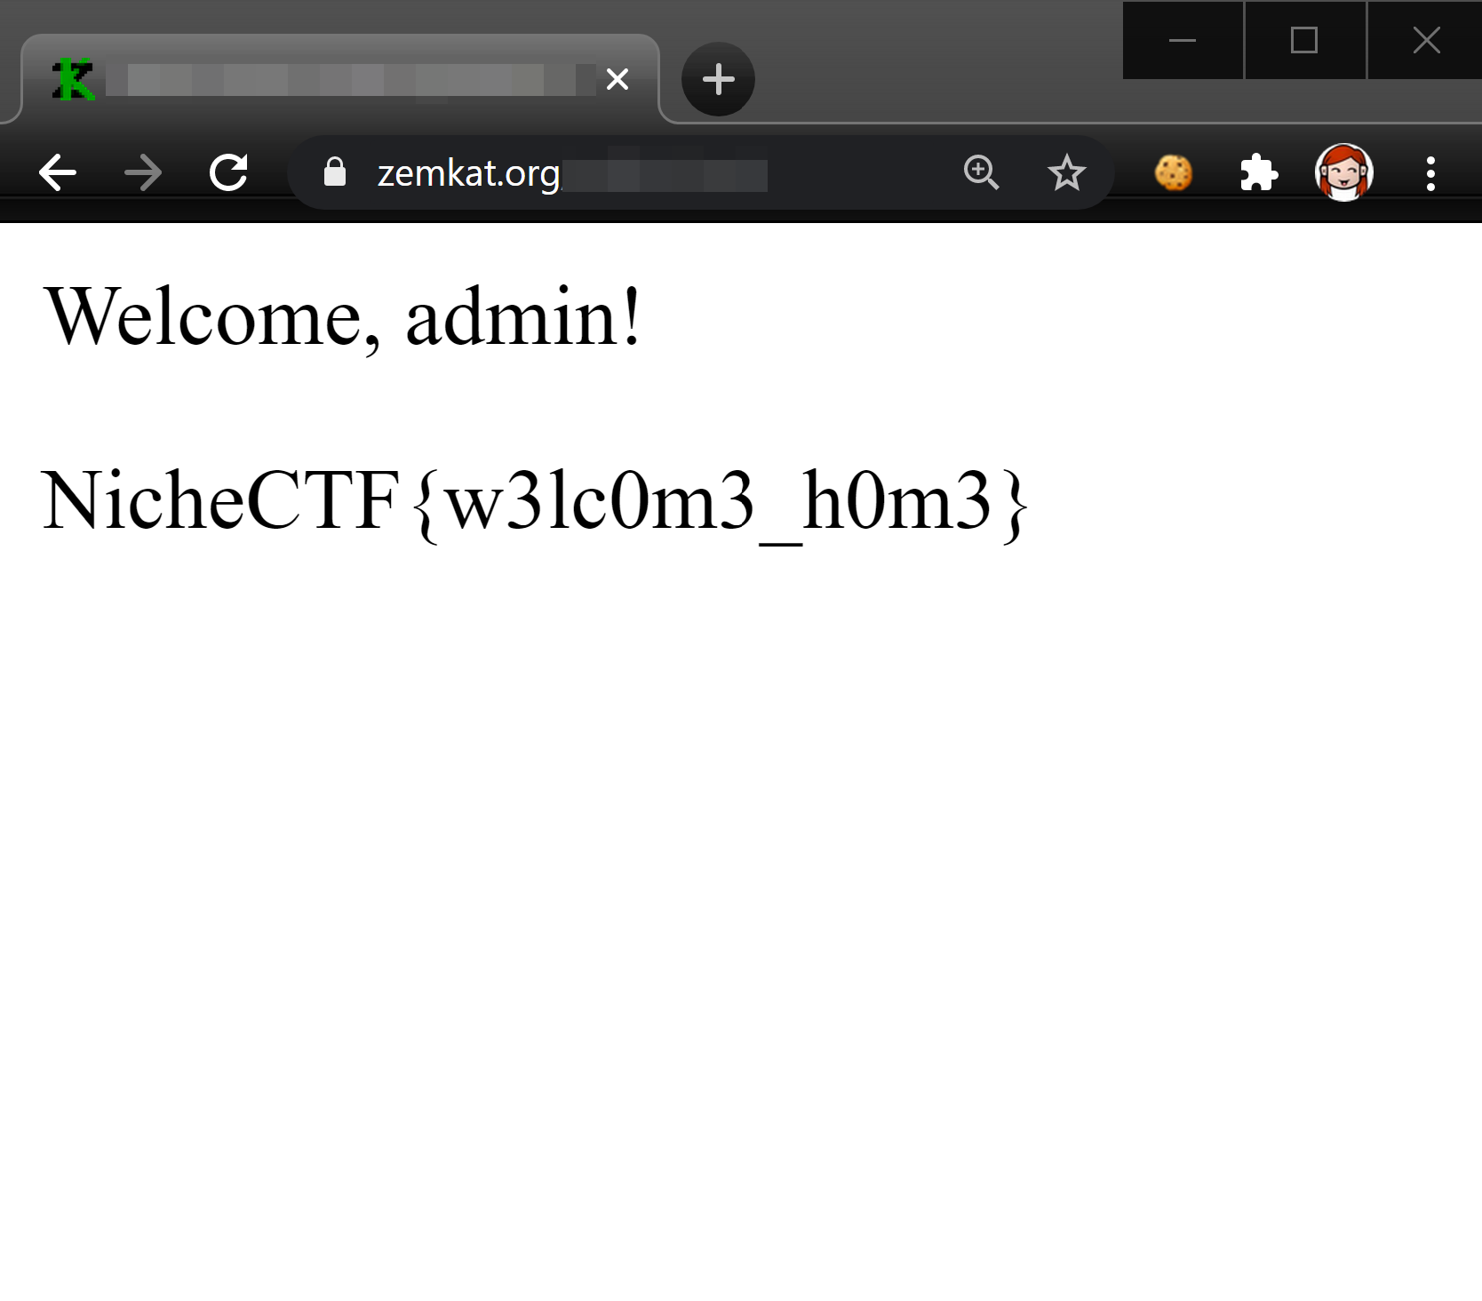
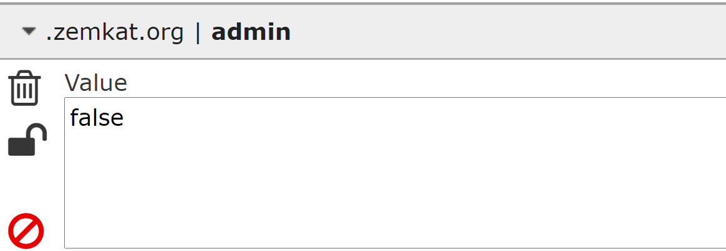
Category: web
Gain access to a web site, or make it reveal more information than intended
Common programming errors
Misconfigurations of common software
SQL injection

Slide 10
Other categories
Social engineering
Binary
pwn
Incident Response
Forensics
Game hacking
Mathematics
Programming
Reversing
OSINT

Slide 11


Slide 12
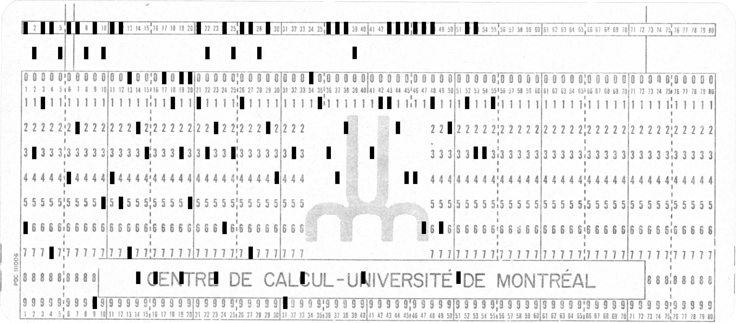
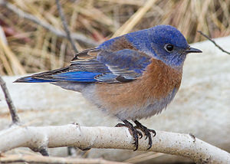

Category: MISCellaneous

Slide 13
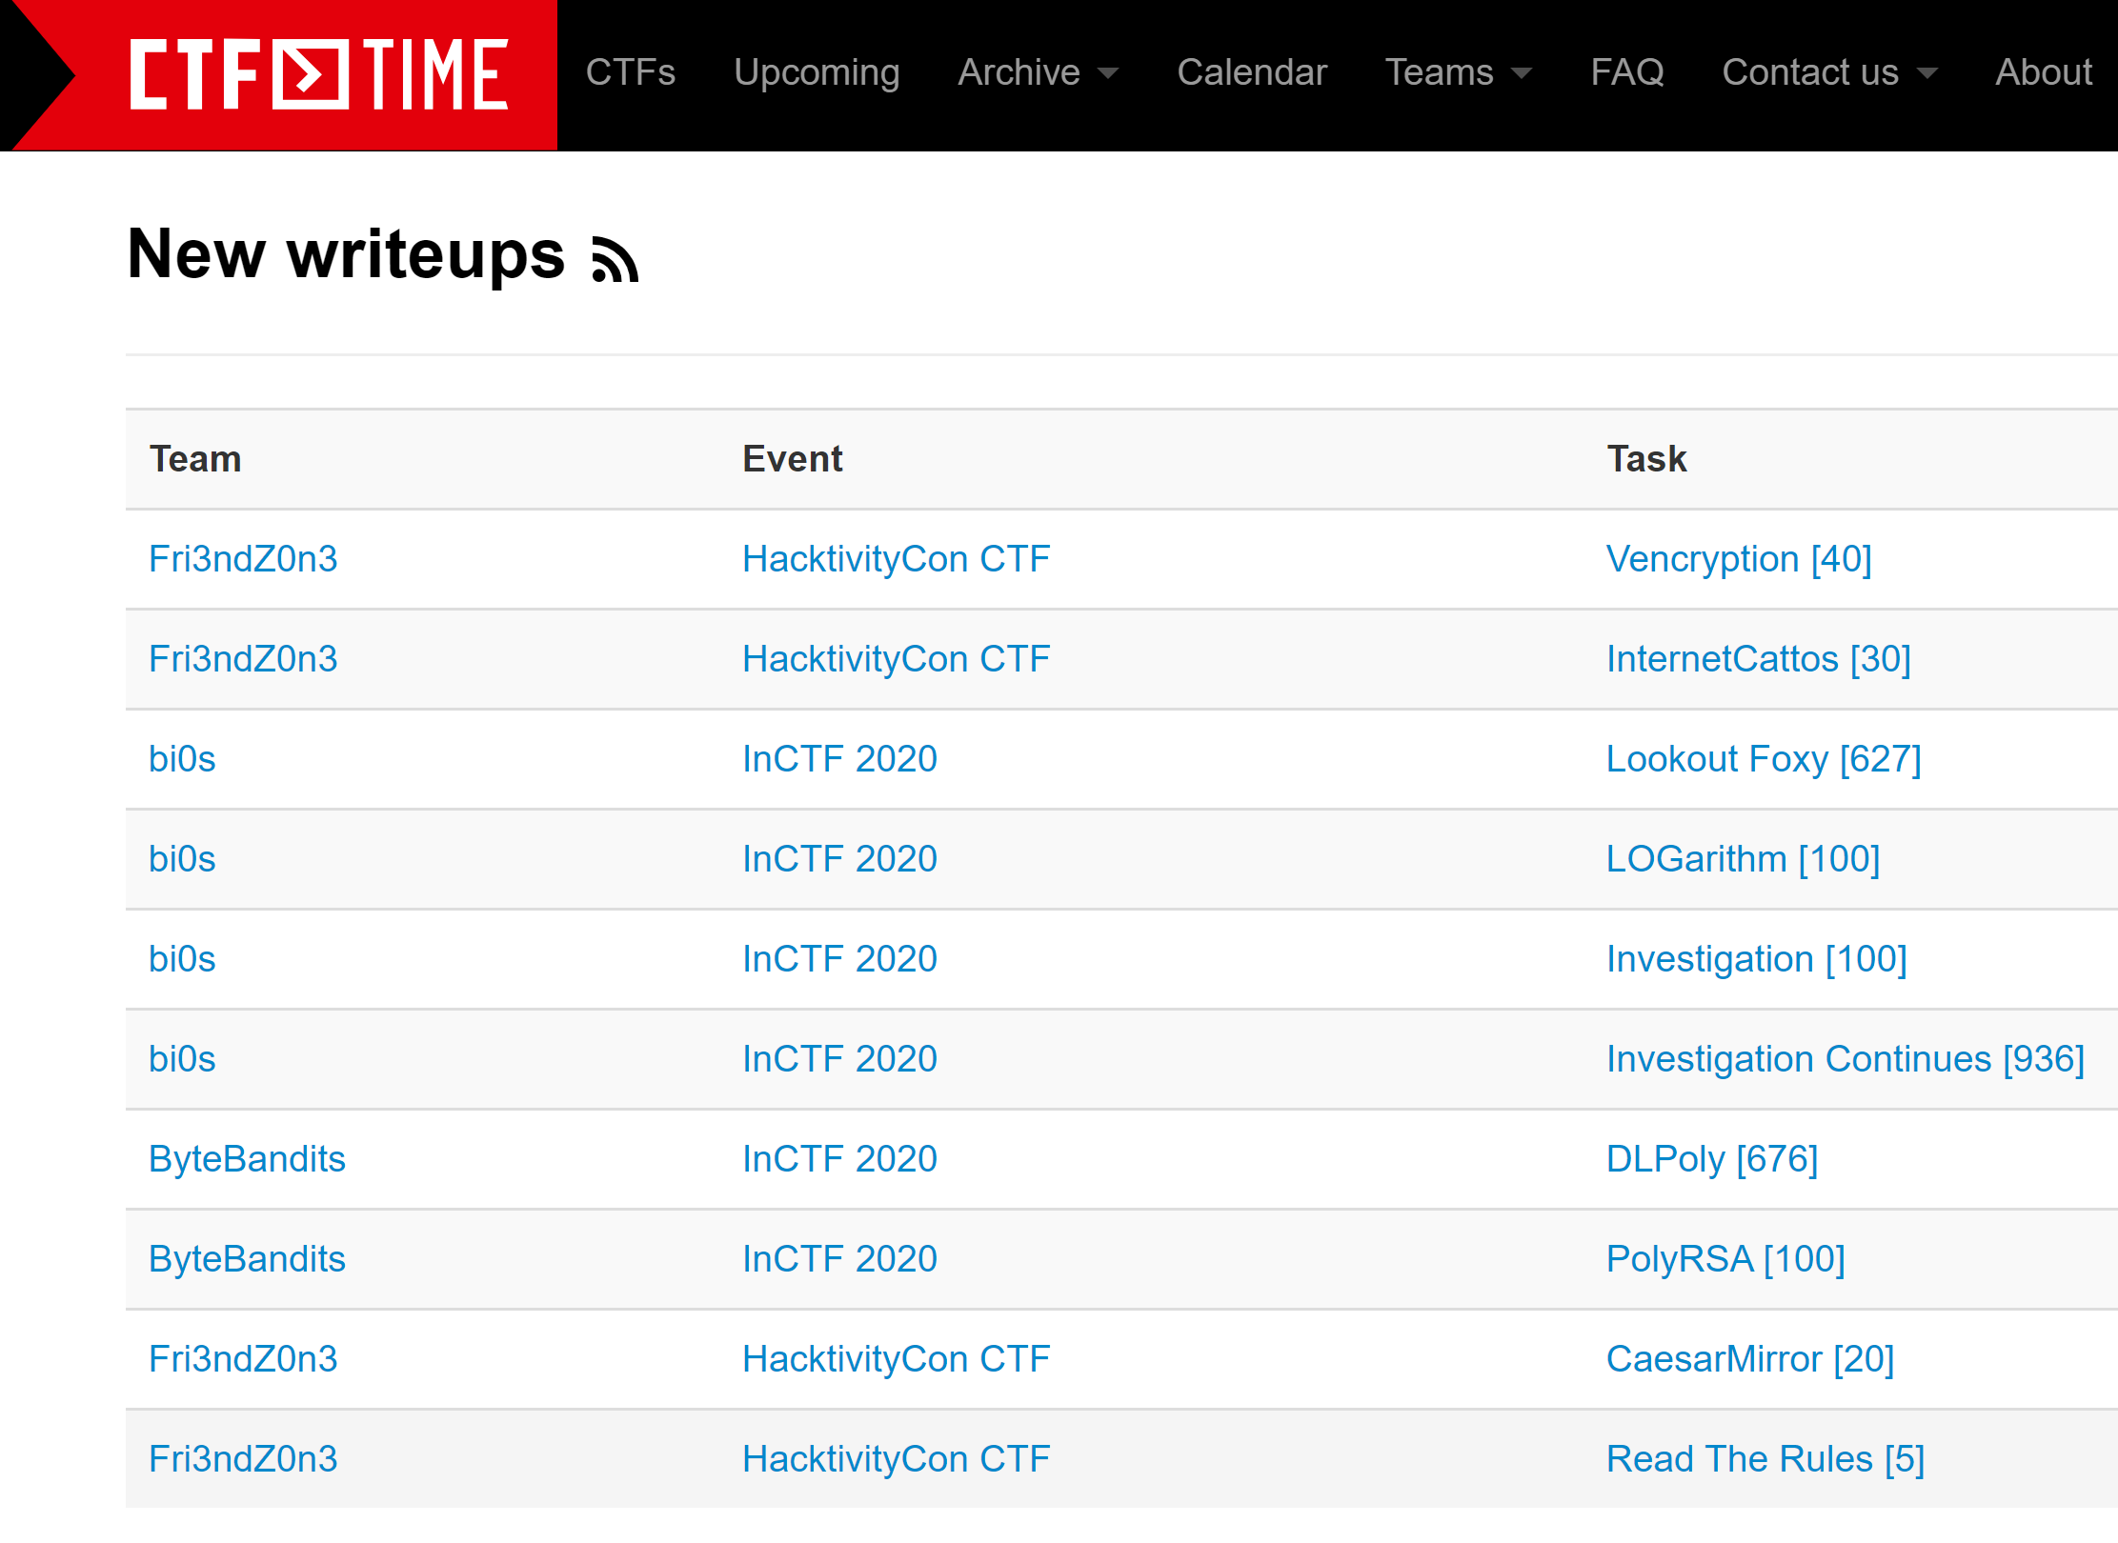
Write-ups
Players write up and share exactly how they solved challenges
Write-ups typically appear in the week following a CTF
Reading them is a good way to get better at CTF

Slide 14
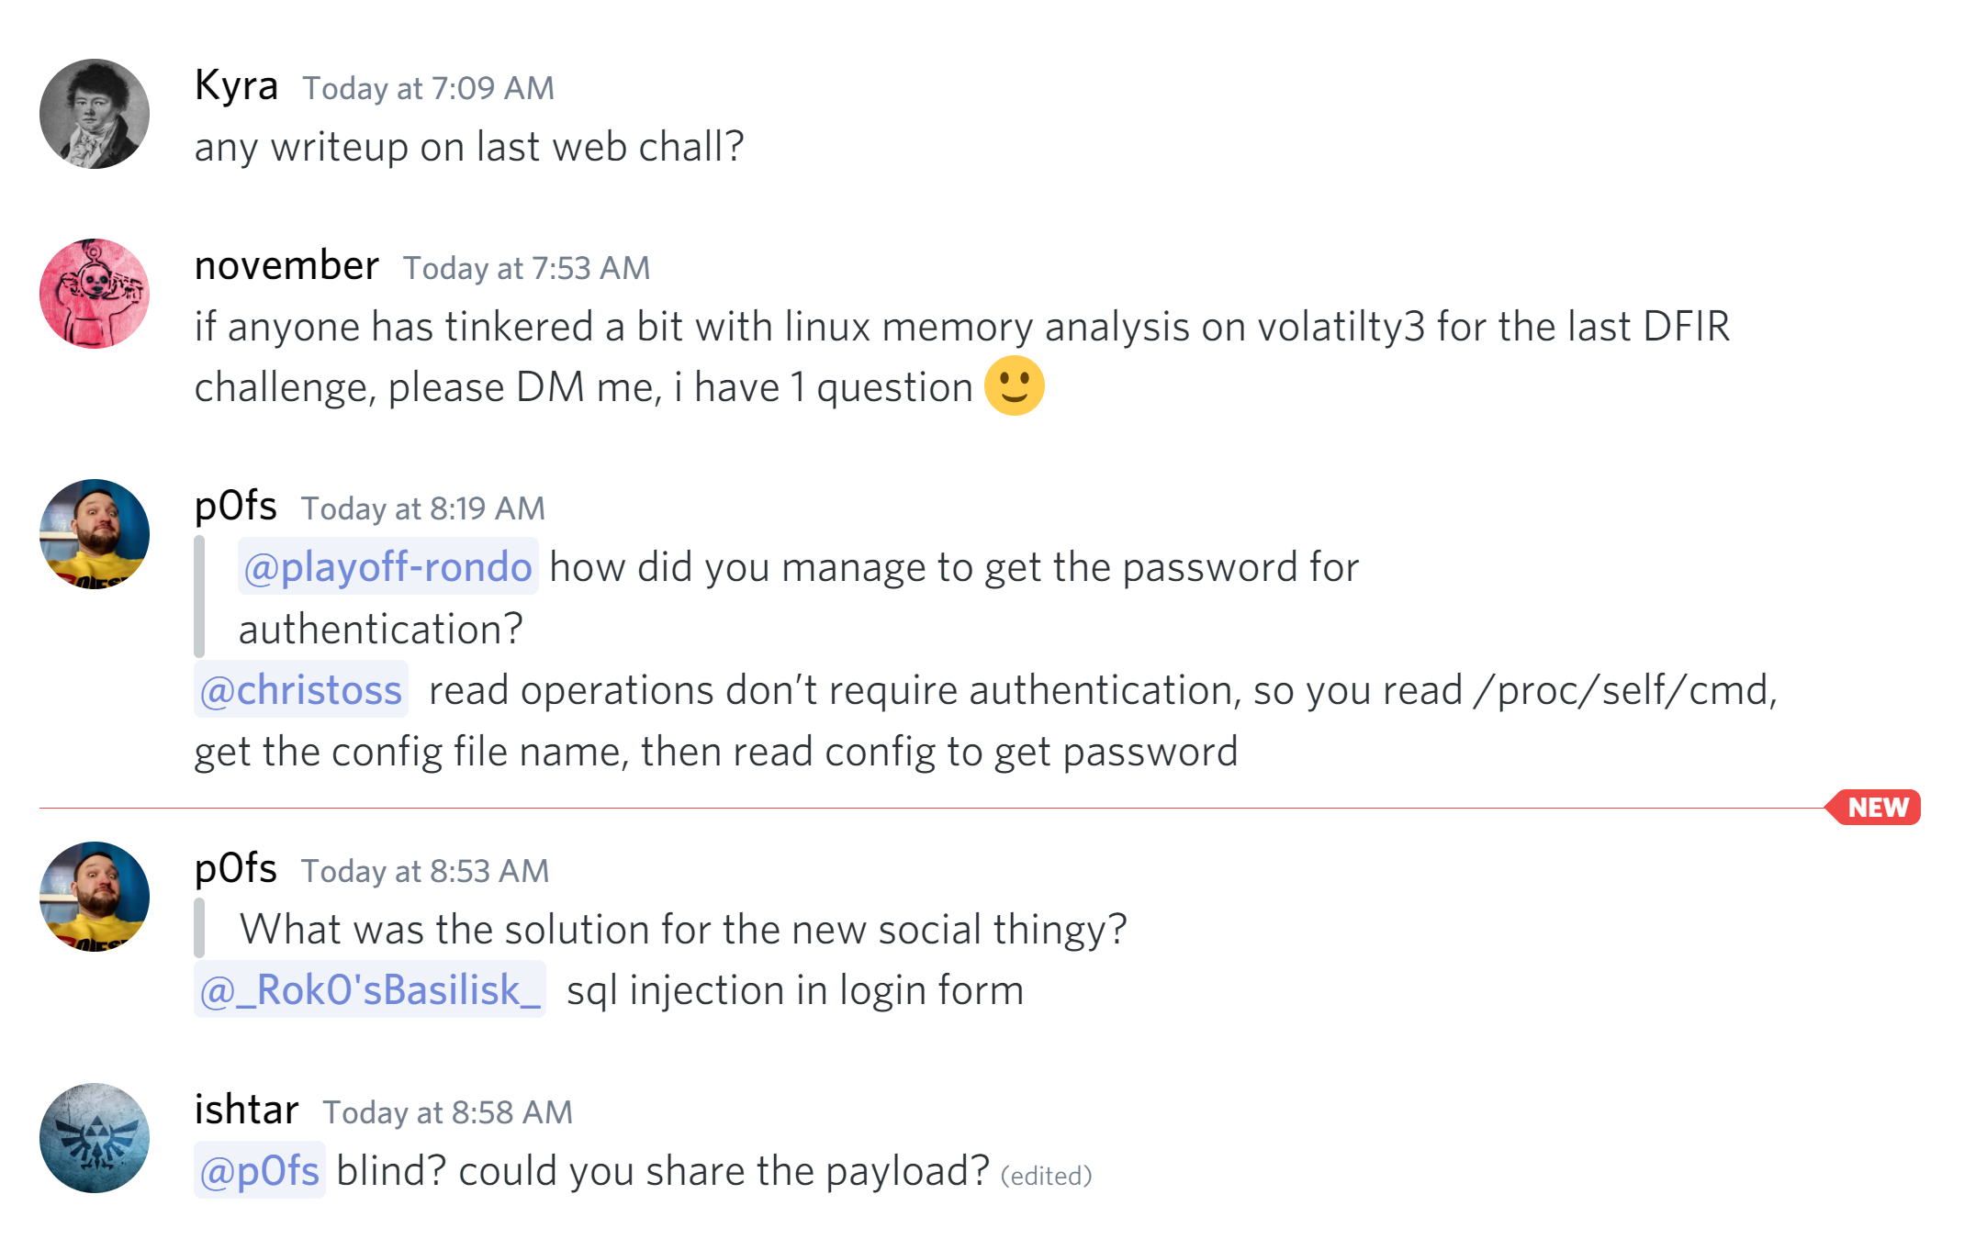
Learning from others
Strong culture of sharing knowledge
Challenge creators and other players are eager to help you!
No hoarding of knowledge to maintain advantage or re-use challenges

Slide 15

WHY CTF?
Puzzles are fun ☺
Learn new skills and tools
Become more security conscious
Learn by doing

Slide 16
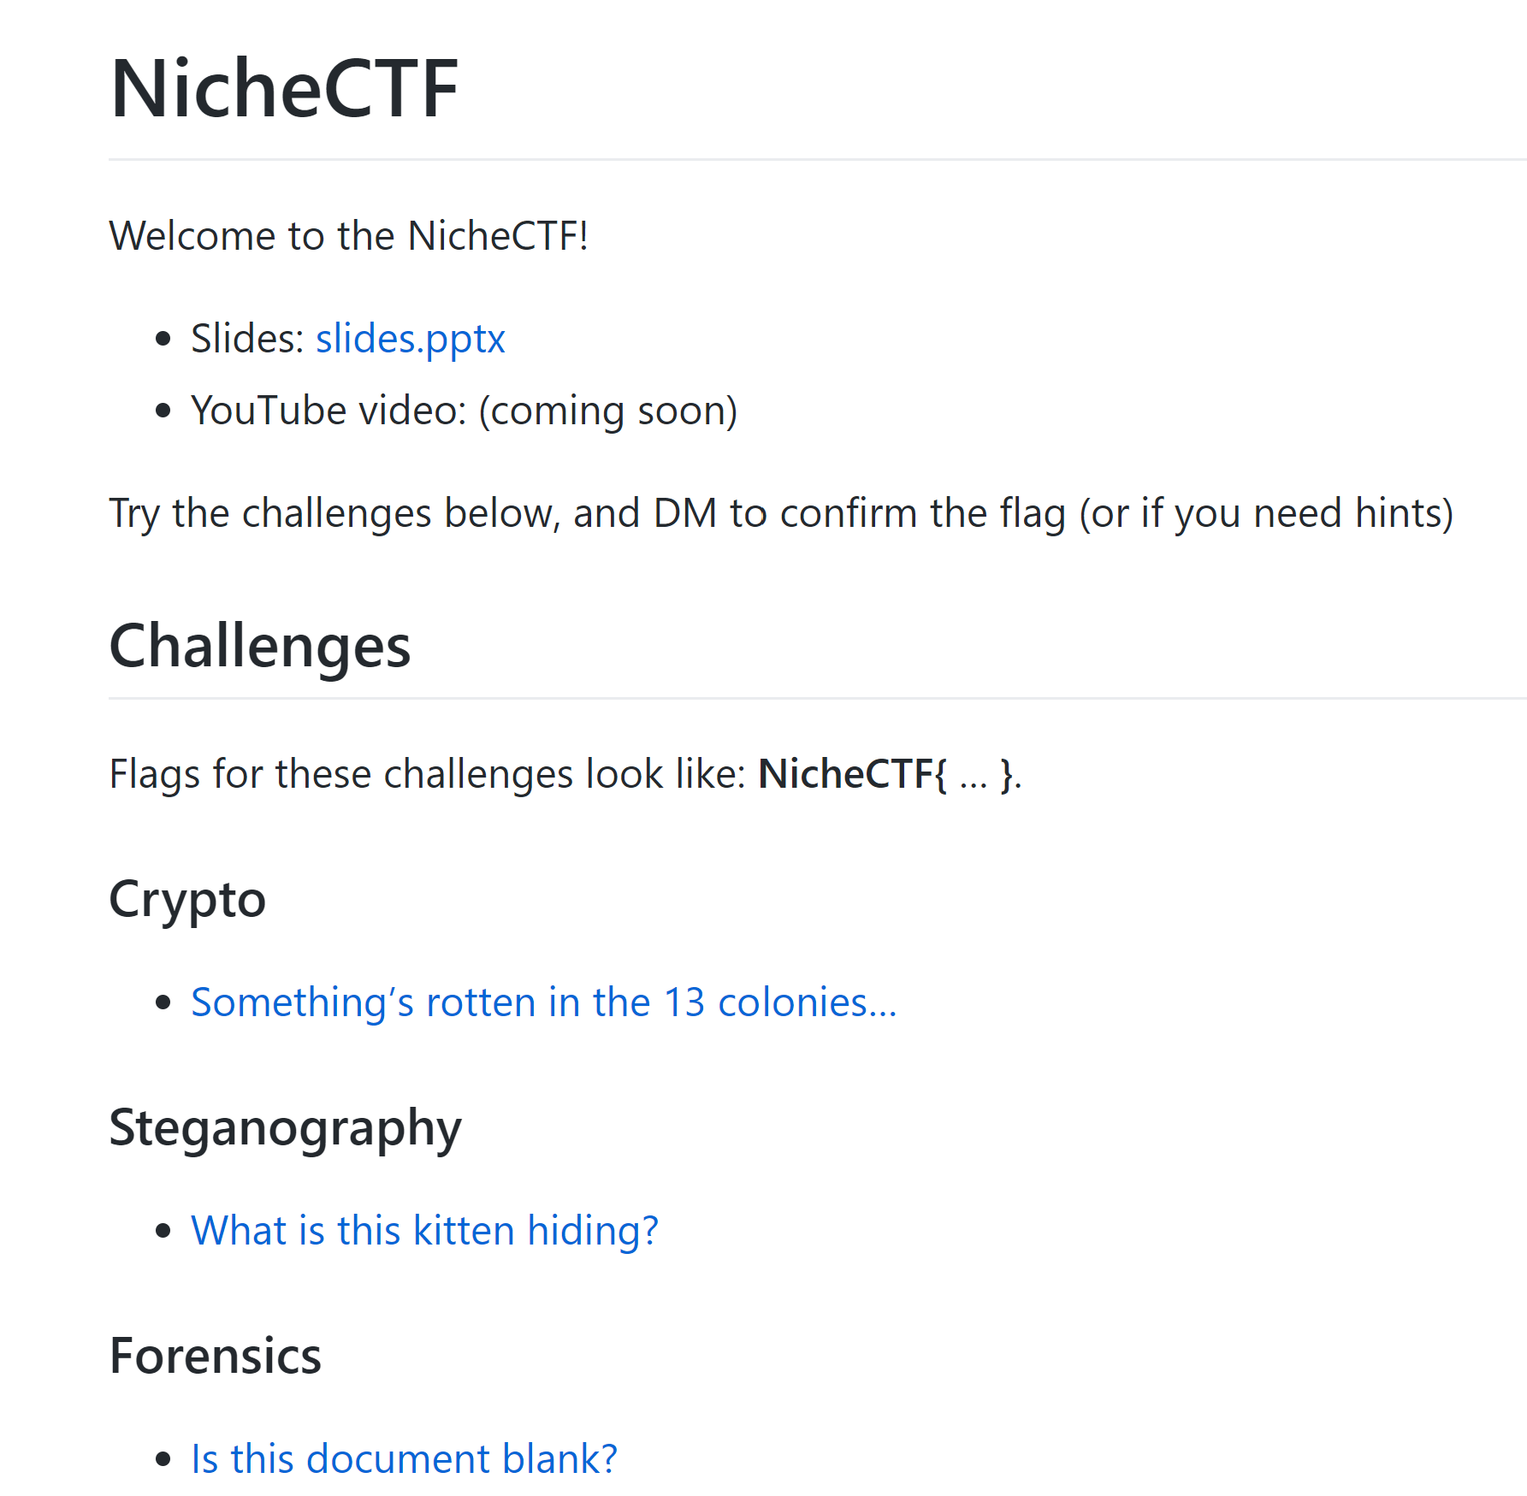
Activity: Niche CTF!
Online Unconference of Niche Interests CTF:
https://zemkat.github.io/NicheCTF/
To submit your flags:
Send them to me as a DM on Discord or Twitter and I’ll confirm

Slide 17
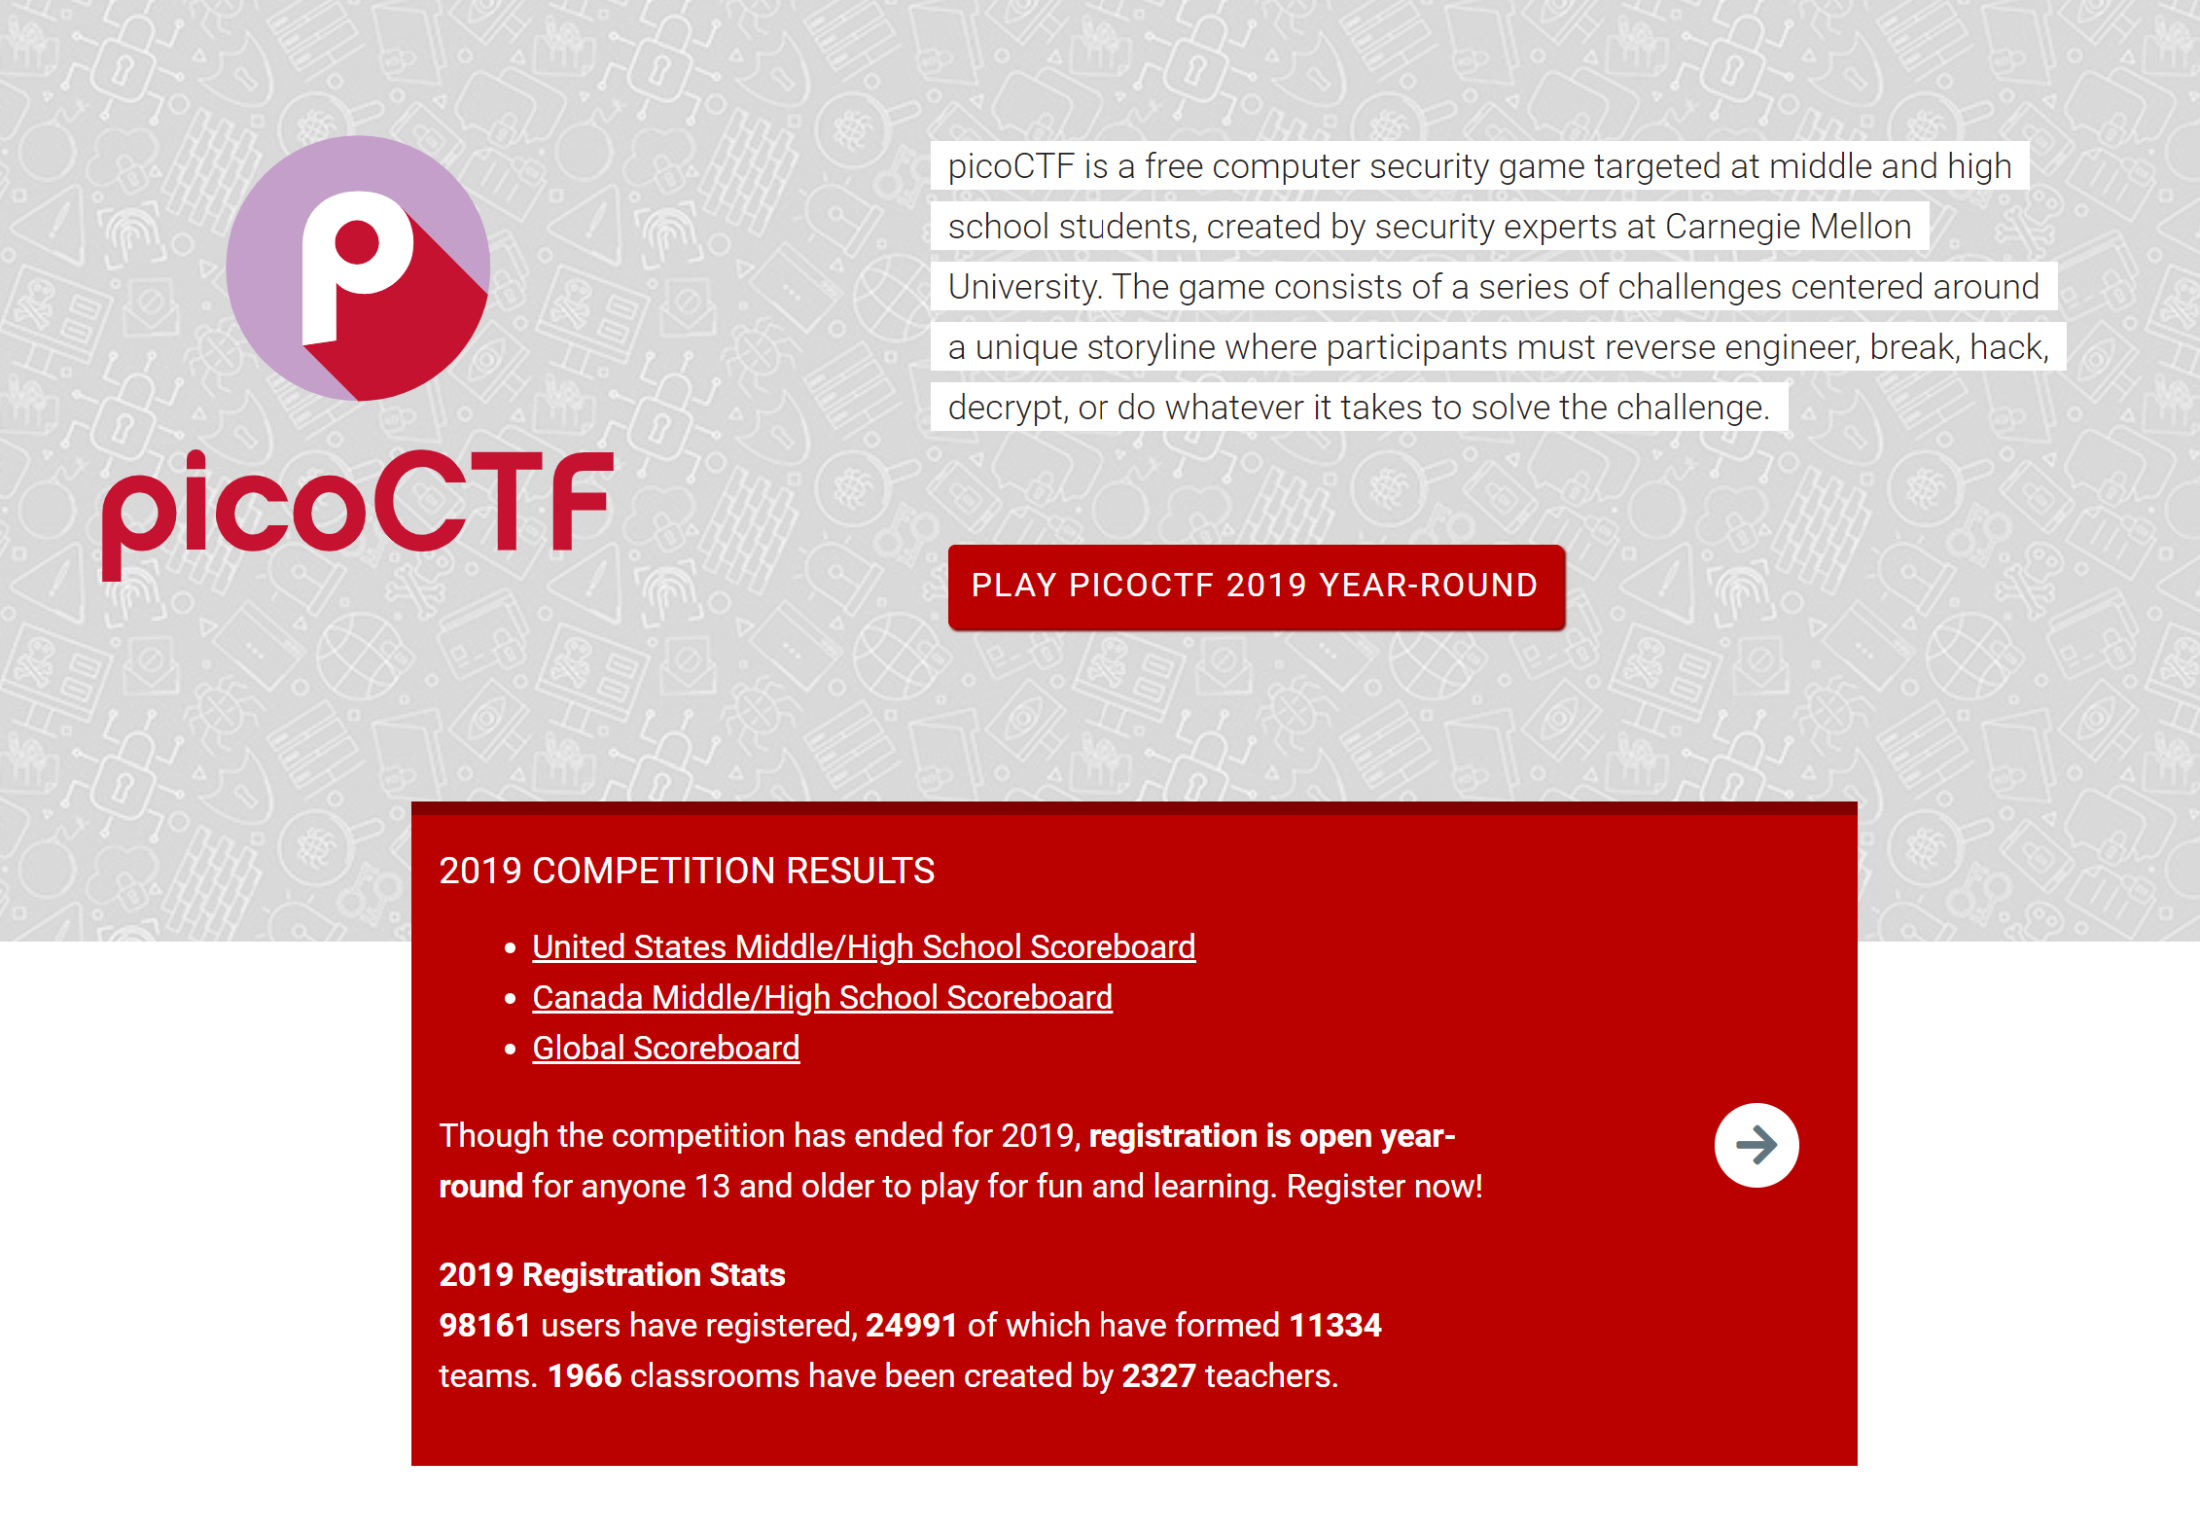
https://picoctf.com
CTF aimed at middle school and high school students
Next competition: March 16-30, 2021
Last year’s problems available year-round

Slide 18

Any questions?
Contact me: Kathryn Lybarger
Ask me on Discord (zemkat#7964)
Ask me on Twitter (@zemkat)

Slide 19
Image credits
“Boys playing capture the flag” – Lydia Liu / CC BY (https://creativecommons.org/licenses/by/2.0)
“DEF CON 17 CTF competition” – Nate Grigg / CC BY (https://creativecommons.org/licenses/by/2.0)
“Cute grey kitten” – By Nicolas Suzor from Brisbane, Australia - Kittens! Uploaded by Kaldari, CC BY-SA 2.0, https://commons.wikimedia.org/w/index.php?curid=15616634
“Western.male” (bluebird) -- Blalonde / CC BY-SA (https://creativecommons.org/licenses/by-sa/4.0)
Exploits of a Mom https://xkcd.com/327/
Pwn Adventure 3: Pwnie Island http://pwnadventure.com/

Slide 20
One more flag!
NicheCTF{3nd1ng_cr3d1ts}

